Slide 1

UNIX Programming
Chapter 2 – Fundamental Concepts

Slide 2
2.1 The Core Operating System: The Kernel
The term operating system is commonly used with two different meanings:
To denote the entire package consisting of the central software managing a computer’s resources and all of the accompanying standard software tools, such as command-line interpreters, graphical user interfaces, file utilities, and editors.
More narrowly, to refer to the central software that manages and allocates computer resources (i.e., the CPU, RAM, and devices)
The term kernel is often used as a synonym for the second meaning.

Slide 3
2.1 The Core Operating System: The Kernel
Among other things, the kernel performs the following tasks:
Process scheduling
Memory management
Provision of a file system
Creation and termination of processes
Access to devices
Networking
Provision of a system call application programming interface (API)

Slide 4
Process scheduling
A computer has one or more central processing units (CPUs), which execute the instructions of programs.
Like other UNIX systems, Linux is a preemptive multitasking operating system.
Multitasking means that multiple processes (i.e., running programs) can simultaneously reside in memory and each may receive use of the CPU(s).
Preemptive means that the rules governing which processes receive use of the CPU and for how long are determined by the kernel process scheduler (rather than by the processes themselves).

Slide 5
Memory Management
While computer memories are enormous by the standards of a decade or two ago, the size of software has also correspondingly grown, so that physical memory (RAM) remains a limited resource that the kernel must share among processes in an equitable and efficient fashion.
Like most modern operating systems, Linux employs virtual memory management

Slide 6
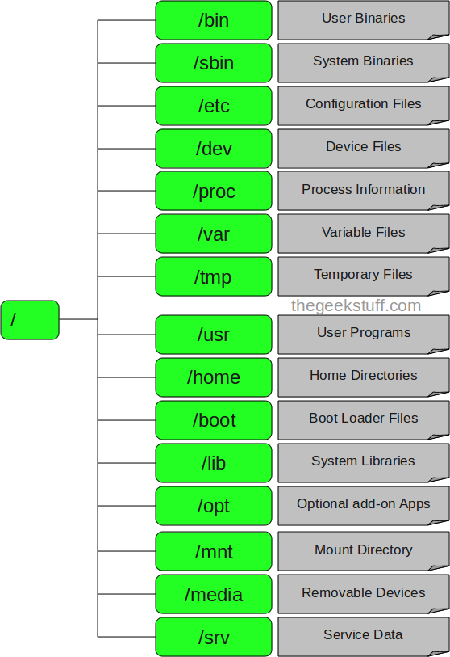
File System
The kernel provides a file system on disk, allowing files to be created, retrieved, updated, deleted, and so on

Slide 7
Creation and termination of processes
The kernel can load a new program into memory, providing it with the resources (e.g., CPU, memory, and access to files) that it needs in order to run.
Such an instance of a running program is termed a process.
Once a process has completed execution, the kernel ensures that the resources it uses are freed for subsequent reuse by later programs

Slide 8
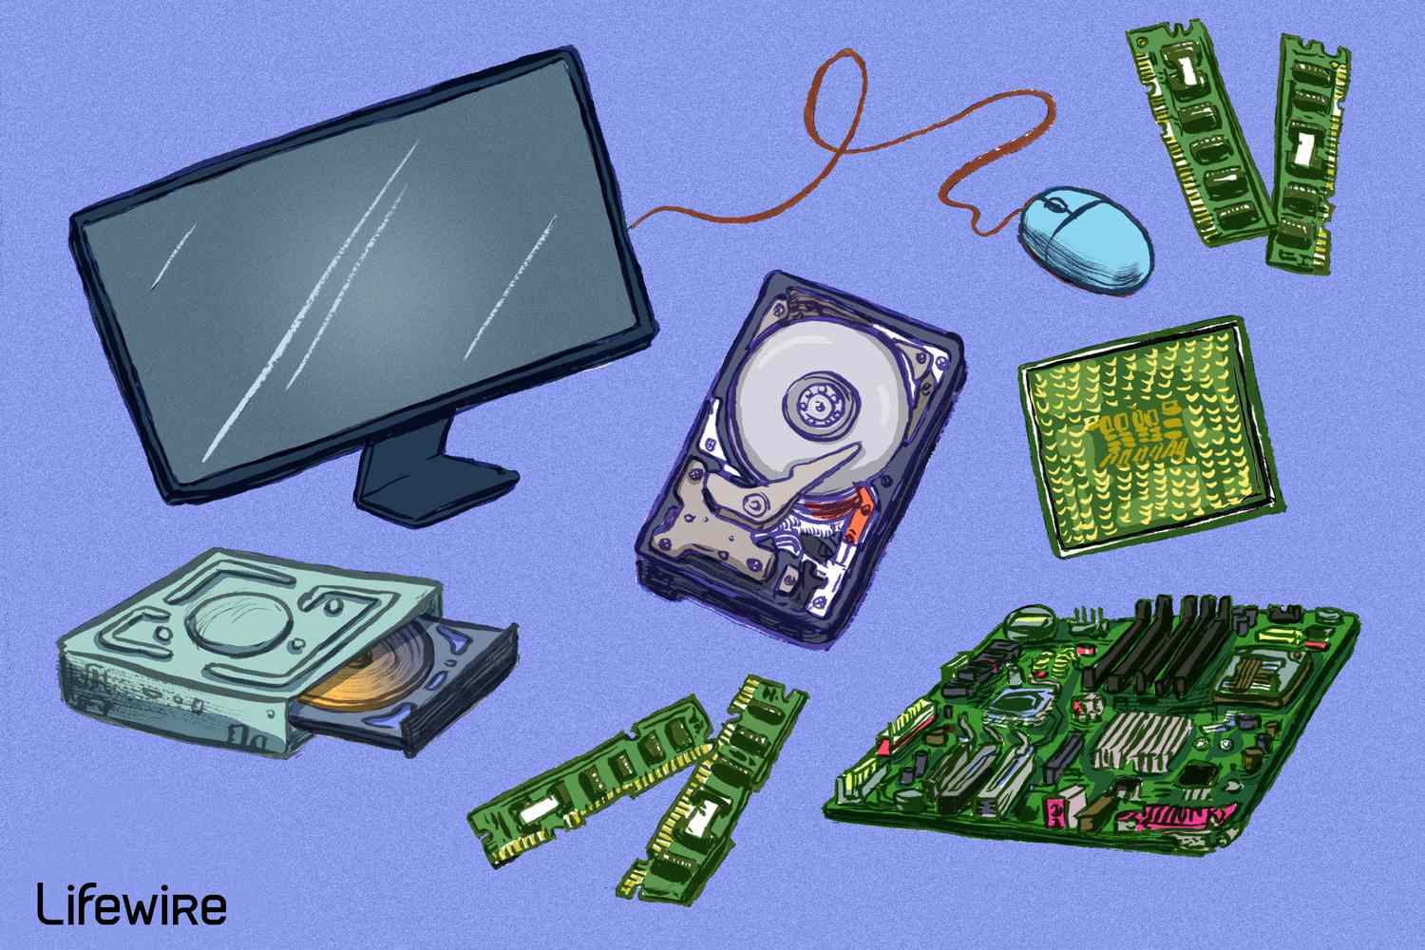
Access to devices
The kernel provides programs with an interface that standardizes and simplifies access to devices, while at the same time arbitrating access by multiple processes to each device.

Slide 9

Networking
The kernel transmits and receives network messages (packets) on behalf of user processes. This task includes routing of network packets to the target system

Slide 10
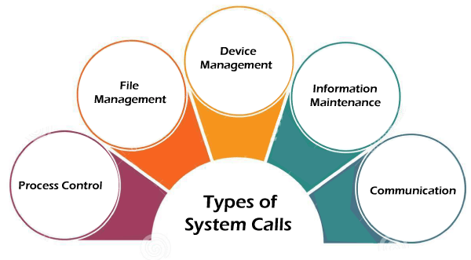
Provision of a system call application programming interface (API)
Processes can request the kernel to perform various tasks using kernel entry points known as system calls.
The Linux system call API is the primary topic that we will be discussing in the next few weeks

Slide 11
2.2 The Shell
A shell is a special-purpose program designed to read commands typed by a user and execute appropriate programs in response to those commands.
Such a program is sometimes known as a command interpreter
The term login shell is used to denote the process that is created to run a shell when the user first logs in

Slide 12
2.2 The Shell
A number of important shells have appeared over time:
Bourne shell (sh): This is the oldest of the widely used shells, and was written by Steve Bourne. It was the standard shell for Seventh Edition UNIX.

Slide 13
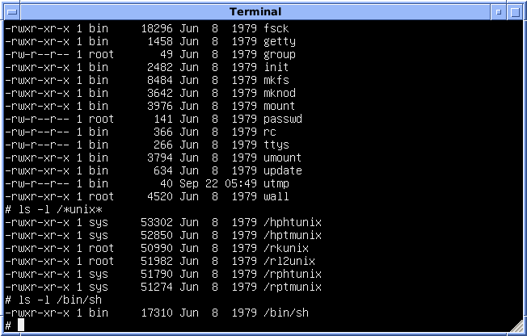

Slide 14
2.2 The Shell
C shell (csh): This shell was written by Bill Joy at the University of California at Berkeley. The name derives from the resemblance of many of the flow-control constructs of this shell to those of the C programming language. The C shell provided several useful interactive features unavailable in the Bourne shell, including command history, command-line editing, job control, and aliases.

Slide 15
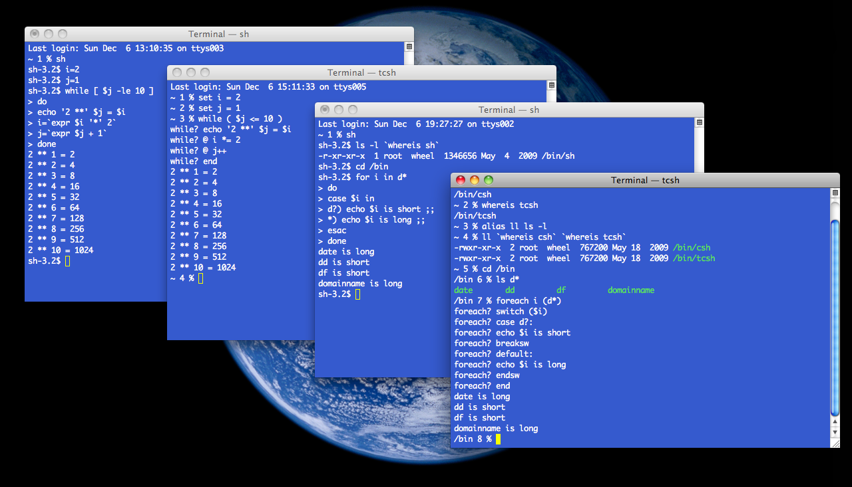

Slide 16
2.2 The Shell
Korn shell (ksh): This shell was written as the successor to the Bourne shell by David Korn at AT&T Bell Laboratories. While maintaining backward compatibility with the Bourne shell, it also incorporated interactive features similar to those provided by the C shell.

Slide 17
2.2 The Shell
Bourne again shell (bash): This shell is the GNU project’s reimplementation of the Bourne shell. It supplies interactive features similar to those available in the C and Korn shells. The principal authors of bash are Brian Fox and Chet Ramey.
Bash is probably the most widely used shell on Linux. (On Linux, the Bourne shell, sh, is actually provided by bash emulating sh as closely as possible.)
The shells are designed not merely for interactive use, but also for the interpretation of shell scripts, which are text files containing shell commands. For this purpose, each of the shells has the facilities typically associated with programming languages: variables, loop and conditional statements, I/O commands, and functions

Slide 18
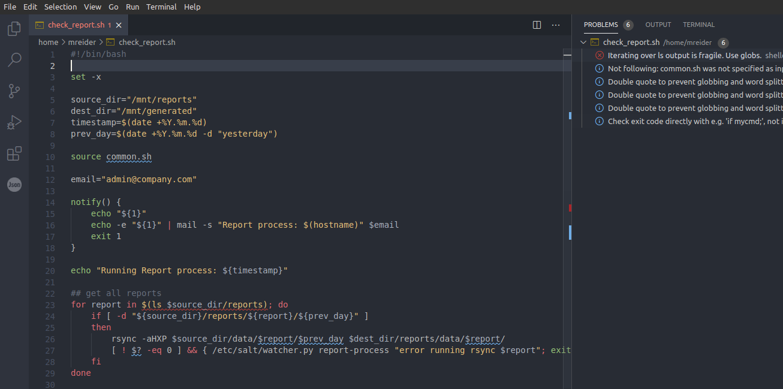

Slide 19
2.3 Users and Groups
Every user of the system has a unique login name (username) and a corresponding numeric user ID (UID). For each user, these are defined by a line in the system password file, /etc/passwd, which includes the following additional information:
Group ID: the numeric group ID of the first of the groups of which the user is a member.
Home directory: the initial directory into which the user is placed after logging in.
Login shell: the name of the program to be executed to interpret user commands.
The password record may also include the user’s password, in encrypted form. However, for security reasons, the password is often stored in the separate shadow password file, which is readable only by privileged users

Slide 20
2.3 Users and Groups
For administrative purposes—in particular, for controlling access to files and other system resources—it is useful to organize users into groups
Each group is identified by a single line in the system group file, /etc/group, which includes the following information:
Group name: the (unique) name of the group.
Group ID (GID): the numeric ID associated with this group.
User list: a comma-separated list of login names of users who are members of this group (and who are not otherwise identified as members of the group by virtue of the group ID field of their password file record).

Slide 21
Superuser
One user, known as the superuser, has special privileges within the system. The superuser account has user ID 0, and normally has the login name root.
On typical UNIX systems, the superuser bypasses all permission checks in the system. Thus, for example, the superuser can access any file in the system, regardless of the permissions on that file, and can send signals to any user process in the system.

Slide 22
2.4 Single Directory Hierarchy, Directories, Links, and Files
The kernel maintains a single hierarchical directory structure to organize all files in the system. (This contrasts with operating systems such as Microsoft Windows, where each disk device has its own directory hierarchy.)
At the base of this hierarchy is the root directory, named / (slash). All files and directories are children or further removed descendants of the root directory.

Slide 23
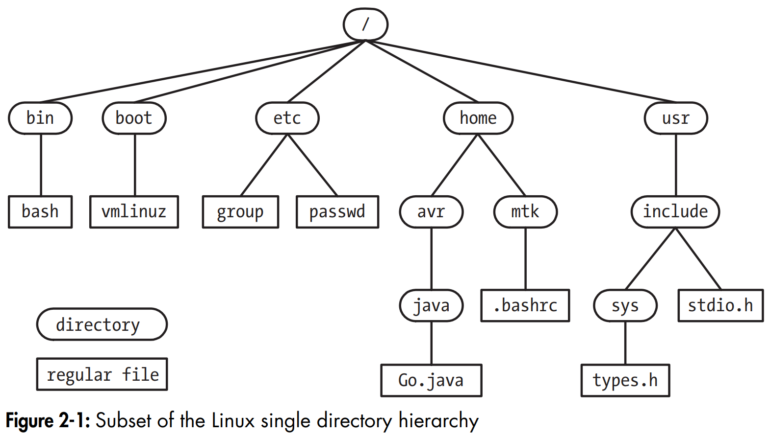

Slide 24
2.4 Single Directory Hierarchy, Directories, Links, and Files
File types
Within the file system, each file is marked with a type, indicating what kind of file it is. One of these file types denotes ordinary data files, which are usually called regular or plain files to distinguish them from other file types. These other file types include devices, pipes, sockets, directories, and symbolic links.
Directories and links
A directory is a special file whose contents take the form of a table of filenames coupled with references to the corresponding files. This filename-plus-reference association is called a link, and files may have multiple links, and thus multiple names, in the same or in different directories.

Slide 25
2.4 Single Directory Hierarchy, Directories, Links, and Files
Symbolic links
Like a normal link, a symbolic link provides an alternative name for a file. But whereas a normal link is a filename-plus-pointer entry in a directory list, a symbolic link is a specially marked file containing the name of another file. (In other words, a symbolic link has a filename-plus-pointer entry in a directory, and the file referred to by the pointer contains a string that names another file.)
Filenames
On most Linux file systems, filenames can be up to 255 characters long. Filenames may contain any characters except slashes (/) and null characters (\0).

Slide 26
2.4 Single Directory Hierarchy, Directories, Links, and Files
Pathnames
A pathname is a string consisting of an optional initial slash (/) followed by a series of filenames separated by slashes
A pathname describes the location of a file within the single directory hierarchy, and is either absolute or relative:
An absolute pathname begins with a slash (/) and specifies the location of a file with respect to the root directory
A relative pathname specifies the location of a file relative to a process’s current working directory

Slide 27
2.5 File I/O Model
One of the distinguishing features of the I/O model on UNIX systems is the concept of universality of I/O. This means that the same system calls (open(), read(), write(), close(), and so on) are used to perform I/O on all types of files, including devices. Thus, a program employing these system calls will work on any type of file.
The I/O system calls refer to open files using a file descriptor, a (usually small) nonnegative integer. A file descriptor is typically obtained by a call to open(), which takes a pathname argument specifying a file upon which I/O is to be performed.
To perform file I/O, C programs typically employ I/O functions contained in the standard C library. This set of functions, referred to as the stdio library, includes fopen(), fclose(), scanf(), printf(), fgets(), fputs(), and so on. The stdio functions are layered on top of the I/O system calls (open(), close(), read(), write(), and so on).

Slide 28
2.4 Single Directory Hierarchy, Directories, Links, and Files
Current working directory
Each process has a current working directory (sometimes just referred to as the process’s working directory or current directory). This is the process’s “current location” within the single directory hierarchy, and it is from this directory that relative pathnames are interpreted for the process
File ownership and permissions
Each file has an associated user ID and group ID that define the owner of the file and the group to which it belongs. The ownership of a file is used to determine the access rights available to users of the file.
Three permission bits may be set for each of the categories of user: read permission allows the contents of the file to be read; write permission allows modification of the contents of the file; and execute permission allows execution of the file, which is either a program or a script to be processed by some interpreter (usually, but not always, one of the shells).

Slide 29
2.6 Programs
Programs normally exist in two forms.
The first form is source code, human-readable text consisting of a series of statements written in a programming language such as C.
To be executed, source code must be converted to the second form: binary machine-language instructions that the computer can understand. (This contrasts with a script, which is a text file containing commands to be directly processed by a program such as a shell or other command interpreter.)
The two meanings of the term program are normally considered synonymous, since the step of compiling and linking converts source code into semantically equivalent binary machine code.

Slide 30
2.7 Processes
Put most simply, a process is an instance of an executing program.
When a program is executed, the kernel loads the code of the program into virtual memory, allocates space for program variables, and sets up kernel bookkeeping data structures to record various information (such as process ID, termination status, user IDs, and group IDs) about the process.
Daemon processes
A daemon is a special-purpose process that is created and handled by the system in the same way as other processes, but which is distinguished by the following characteristics:
It is long-lived. A daemon process is often started at system boot and remains in existence until the system is shut down.
It runs in the background and has no controlling terminal from which it can read input or to which it can write output.
Examples of daemon processes include syslogd, which records messages in the system log, and httpd, which serves web pages via the Hypertext Transfer Protocol (HTTP).

Slide 31
2.8 Memory Mappings
The mmap() system call creates a new memory mapping in the calling process’s virtual address space. Mappings fall into two categories:
A file mapping maps a region of a file into the calling process’s virtual memory. Once mapped, the file’s contents can be accessed by operations on the bytes in the corresponding memory region. The pages of the mapping are automatically loaded from the file as required.
By contrast, an anonymous mapping doesn’t have a corresponding file. Instead, the pages of the mapping are initialized to 0.

Slide 32
2.9 Static and Shared Libraries
An object library is a file containing the compiled object code for a (usually logically related) set of functions that may be called from application programs. Placing code for a set of functions in a single object library eases the tasks of program creation and maintenance.
Modern UNIX systems provide two types of object libraries: static libraries and shared libraries

Slide 33
2.10 Interprocess Communication and Synchronization
A running Linux system consists of numerous processes, many of which operate independently of each other. Some processes, however, cooperate to achieve their intended purposes, and these processes need methods of communicating with one another and synchronizing their actions.
Therefore, Linux, like all modern UNIX implementations, provides a rich set of mechanisms for interprocess communication (IPC), including the following:
signals, which are used to indicate that an event has occurred;
pipes (familiar to shell users as the | operator) and FIFOs, which can be used to transfer data between processes;
sockets, which can be used to transfer data from one process to another, either on the same host computer or on different hosts connected by a network;
file locking, which allows a process to lock regions of a file in order to prevent other processes from reading or updating the file contents;

Slide 34
2.10 Interprocess Communication and Synchronization
message queues, which are used to exchange messages (packets of data) between processes;
semaphores, which are used to synchronize the actions of processes; and
shared memory, which allows two or more processes to share a piece of memory. When one process changes the contents of the shared memory, all of the other processes can immediately see the changes

Slide 35
2.11 Signals
Signals are often described as “software interrupts.” The arrival of a signal informs a process that some event or exceptional condition has occurred. There are various types of signals, each of which identifies a different event or condition.
Each signal type is identified by a different integer, defined with symbolic names of the form SIGxxxx.

Slide 36
2.12 Threads
In modern UNIX implementations, each process can have multiple threads of execution. One way of envisaging threads is as a set of processes that share the same virtual memory, as well as a range of other attributes. Each thread is executing the same program code and shares the same data area and heap.
However, each thread has it own stack containing local variables and function call linkage information.
Threads can communicate with each other via the global variables that they share. The threading API provides condition variables and mutexes, which are primitives that enable the threads of a process to communicate and synchronize their actions, in particular, their use of shared variables.

Slide 37
2.13 Process Groups and Shell Job Control
Each program executed by the shell is started in a new process.
All major shells, except the Bourne shell, provide an interactive feature called job control, which allows the user to simultaneously execute and manipulate multiple commands or pipelines. In job-control shells, all of the processes in a pipeline are placed in a new process group or job
Each process in a process group has the same integer process group identifier, which is the same as the process ID of one of the processes in the group, termed the process group leader.
The kernel allows for various actions, notably the delivery of signals, to be performed on all members of a process group. Job-control shells use this feature to allow the user to suspend or resume all of the processes in a pipeline.

Slide 38
2.14 Sessions, Controlling Terminals, and Controlling Processes
A session is a collection of process groups ( jobs). All of the processes in a session have the same session identifier. A session leader is the process that created the session, and its process ID becomes the session ID
Sessions usually have an associated controlling terminal. The controlling terminal is established when the session leader process first opens a terminal device.
As a consequence of opening the controlling terminal, the session leader becomes the controlling process for the terminal
At any point in time, one process group in a session is the foreground process group (foreground job), which may read input from the terminal and send output to it. If the user types the interrupt character (usually Control-C) or the suspend character (usually Control-Z) on the controlling terminal, then the terminal driver sends a signal that kills or suspends (i.e., stops) the foreground process group.
A session can have any number of background process groups (background jobs), which are created by terminating a command with the ampersand (&) character

Slide 39
2.15 Pseudoterminals
A pseudoterminal is a pair of connected virtual devices, known as the master and slave. This device pair provides an IPC channel allowing data to be transferred in both directions between the two devices.
The key point about a pseudoterminal is that the slave device provides an interface that behaves like a terminal, which makes it possible to connect a terminal-oriented program to the slave device and then use another program connected to the master device to drive the terminal-oriented program.
Pseudoterminals are used in a variety of applications, most notably in the implementation of terminal windows provided under an X Window System login and in applications providing network login services, such as telnet and ssh.

Slide 40
2.16 Date and Time
Two types of time are of interest to a process:
Real time is measured either from some standard point (calendar time) or from some fixed point, typically the start, in the life of a process (elapsed or wall clock)
Process time, also called CPU time, is the total amount of CPU time that a process has used since starting. CPU time is further divided into system CPU time, the time spent executing code in kernel mode (i.e., executing system calls and performing other kernel services on behalf of the process), and user CPU time, the time spent executing code in user mode (i.e., executing normal program code).
The time command displays the real time, the system CPU time, and user CPU time taken to execute the processes in a pipeline

Slide 41
Additional Resources
Five Things Linux Does Better Than Windows - YouTube

